Slide 1

Capstone Project - Phase A
Co-Bie
Expand your social circle by connecting with individuals who share your hobbies
Supervisor
Prof.Zeev Brazily
Students
Raz Avraham
Amit Kempner

Slide 2






Roadmap
Introduction
Research
Solution
Product
Verification
Challenges

Slide 3
Introduction
Have you ever had a hobby that you had no one to share it with?
Today, all over the world, there are many people with different hobbies, many of them have no one to share their hobbies with.
Our mission is to bridge the gap for individuals around the world who are searching for others who share their passions.
Our platform is designed to solve that problem by facilitating spontaneous and efficient connections between people with common hobbies.

Slide 4
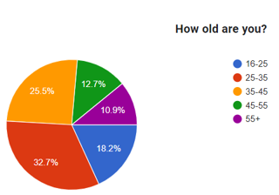
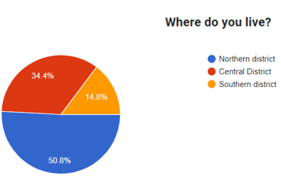
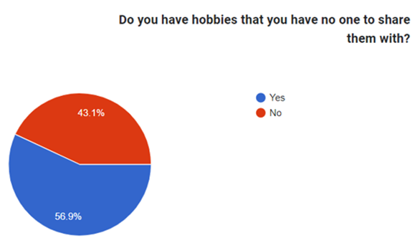
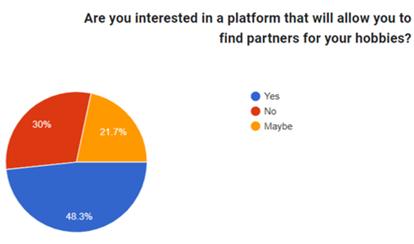
Research
In order to understand the magnitude of the problem we are facing, we conducted research and analysis.

Slide 5
Solution
Co-Bie is an android application designed to solve the issue of individuals not having anyone to share their hobbies with.
The app will allow users to create and participate in meetings with others who have the same hobbies.
Users will be able to search for existing hobby-based meetings or create their own and invite others to join.
The app will be user-friendly and easy to navigate, making it easy for anyone to join and participate in meetings.
Co-Bie aims to bring people with similar interests together and provide a platform for them to share their hobbies and make new friends.

Slide 6
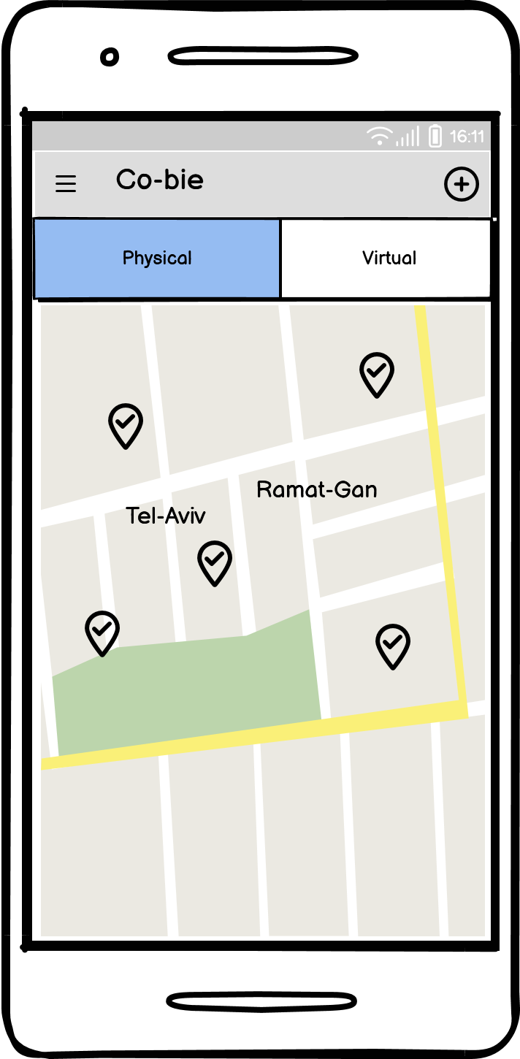
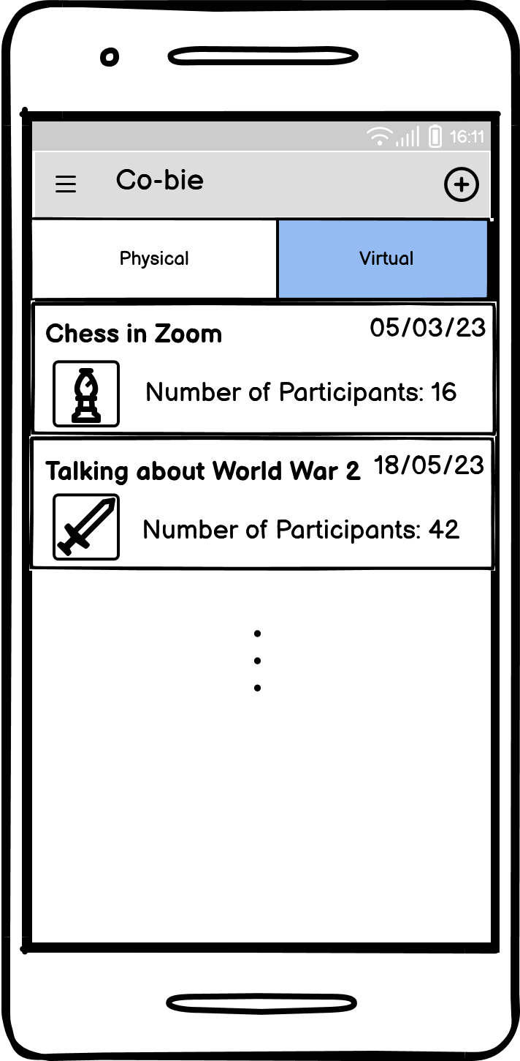
Product
Physical Event
Virtual Event

Slide 7
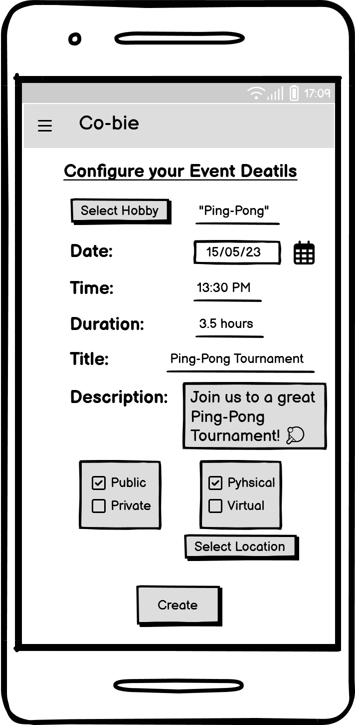
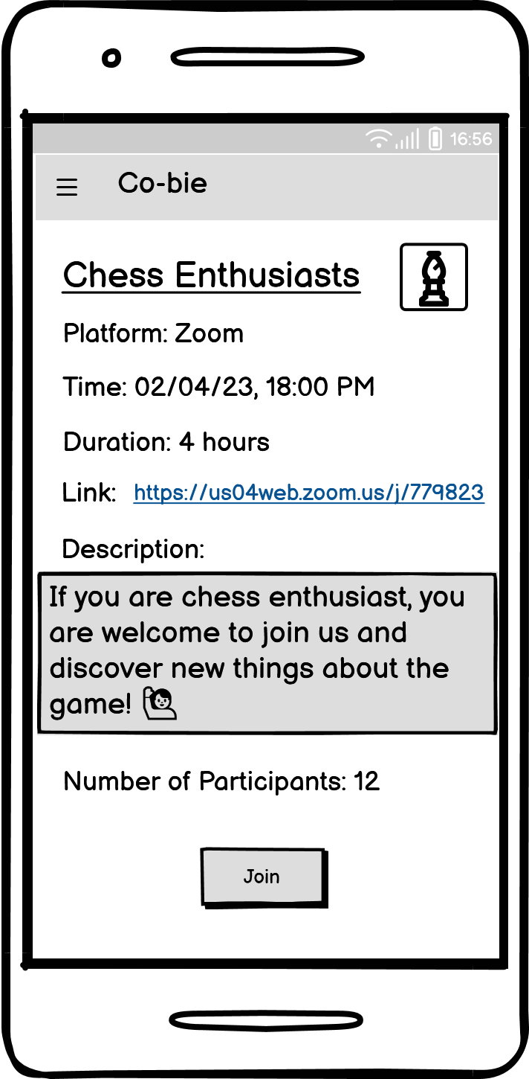
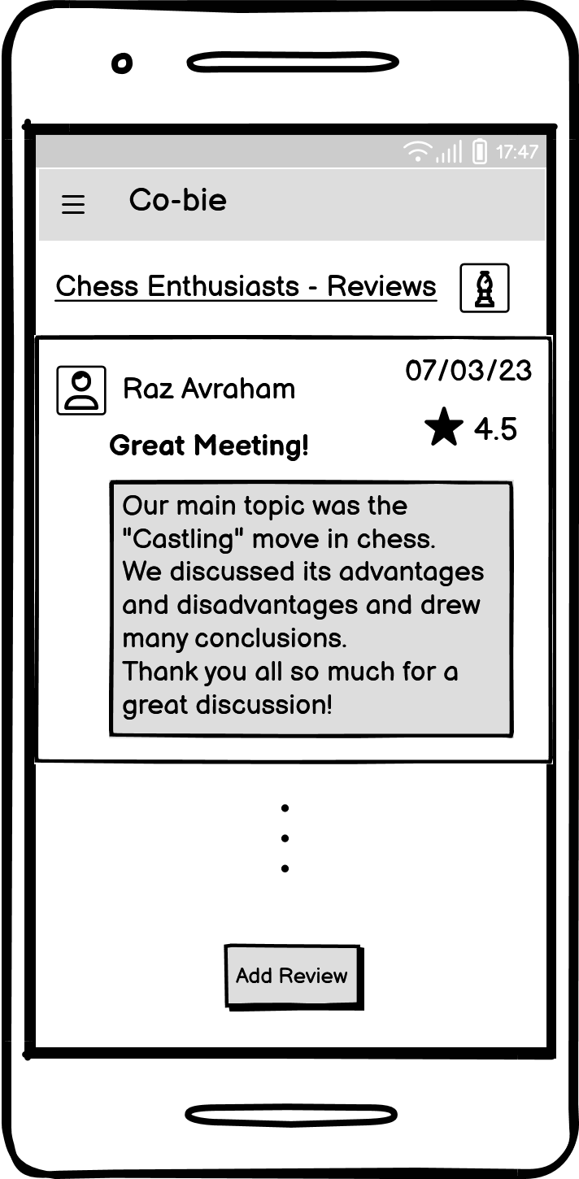
Product
Create Event
Join Event
Event Review

Slide 8
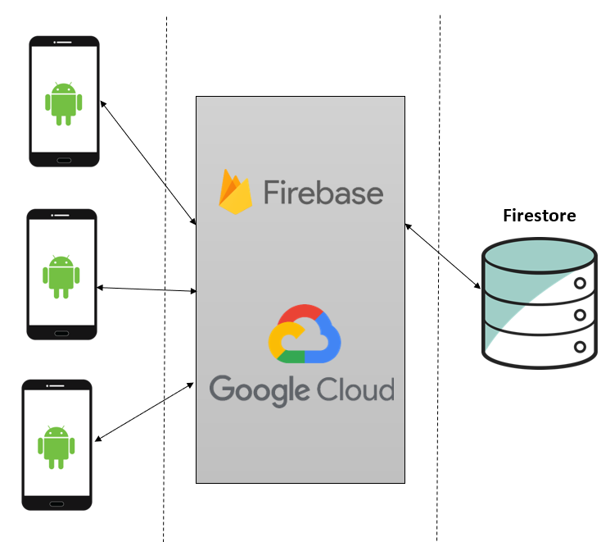
Software Architecture

Slide 9
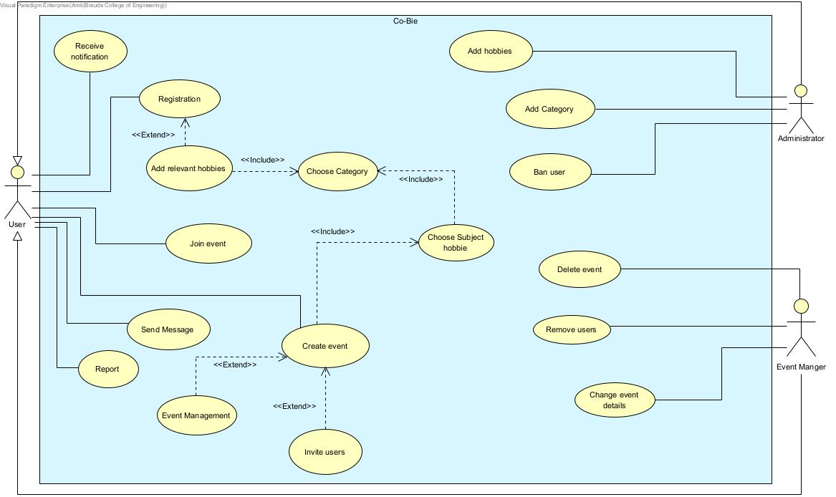
Use-Case Diagram

Slide 10
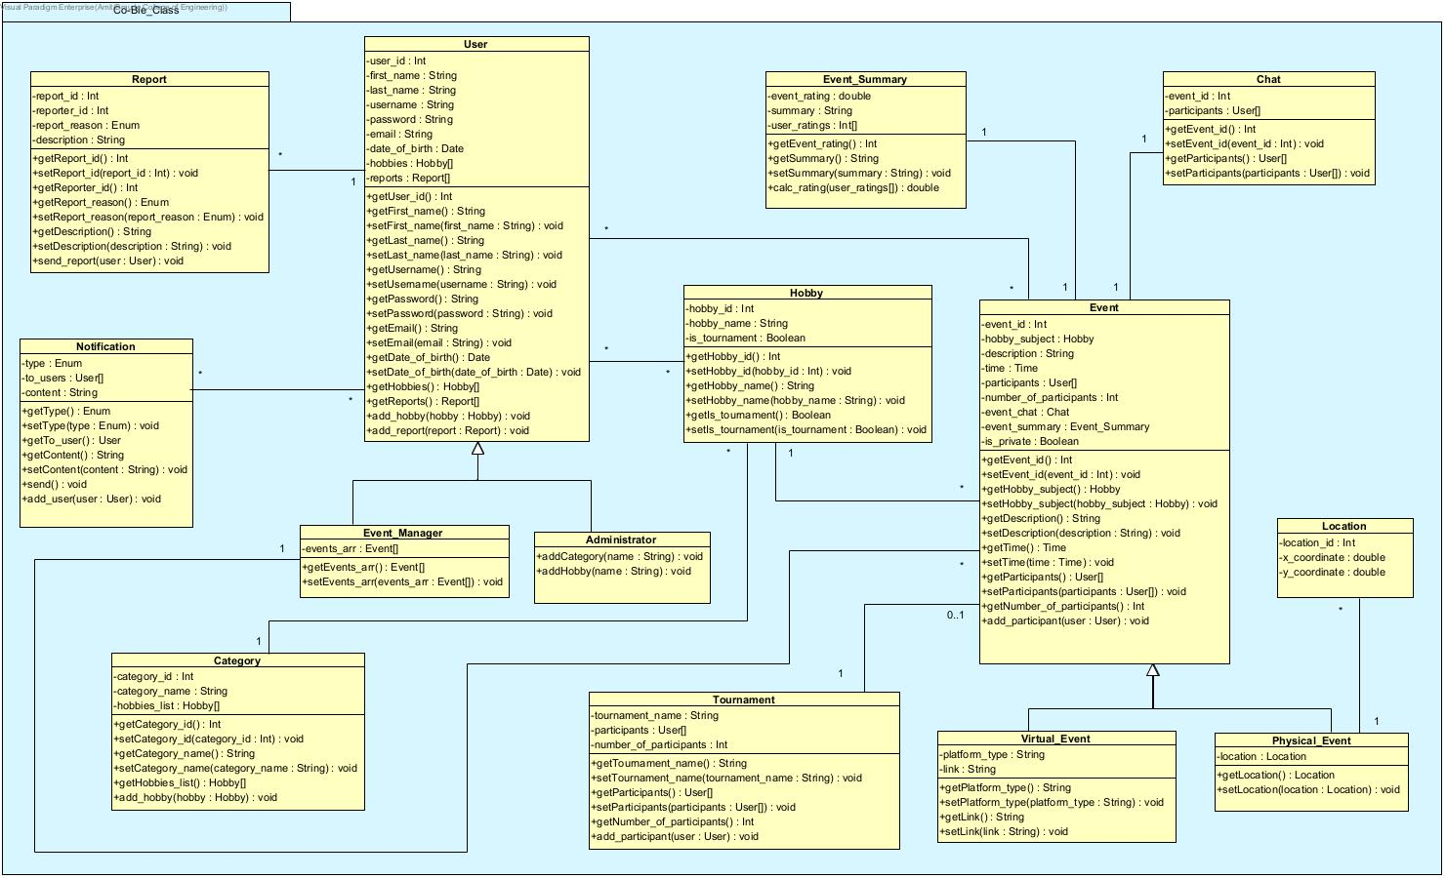
Class Diagram

Slide 11
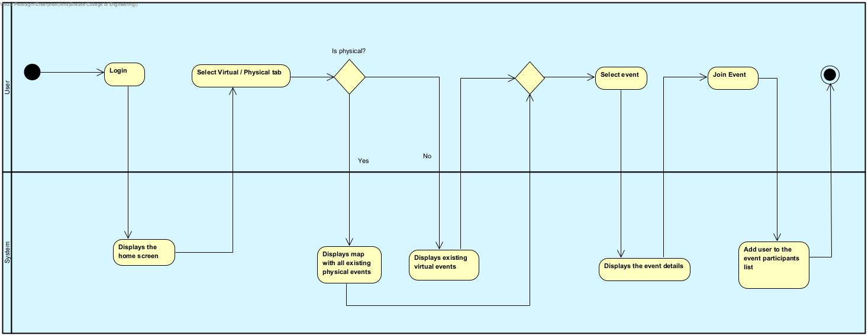
Activity Diagram – Join Event

Slide 12
Verification
Unit Testing
Create an Event
Number | Test Subject | Expected Result
1 | Event created successfully | Event added to the event table in the DB with appropriate details
2 | Event creation failed (as a result of invalid fields) | Event has not been added to the events table in the DB
3 | Event creation failed (as a result of system failure) | Event has not been added to the events table in the DB - throw an exception
Add Review
Number | Test Subject | Expected Result
1 | The user add review successfully | Review has been added to the event reviews list in the DB
2 | Failed to add review (as a result of invalid fields) | Review has not been added to the event reviews list in the DB
3 | Failed to add review (as a result of system failure) | Review has not been added to the event reviews list in the DB – throw an exception

Slide 13
Unit Testing
Add Hobby (as Administrator)
Number | Test Subject | Expected Result
1 | The administrator add new category successfully | Category has been added to the Categories table in the DB
2 | The administrator add new hobby successfully | Hobby has been added to the Hobbies table in the DB
3 | Failed to add new category (as a result of invalid fields) | Category has not been added to the Categories table in the DB
4 | Failed to add new category (as a result of system failure) | Category has not been added to the Categories table in the DB – throw an exception
5 | Failed to add new hobby (as a result of invalid fields) | Hobby has not been added to the Hobbies table in the DB
6 | Failed to add new hobby (as a result of system failure) | Hobby has not been added to the Hobbies table in the DB – throw an exception

Slide 14
Functional Testing
Registration
Number | Test Subject | Expected Result
1 | Enter a username that already exists in the system | System Displays: “The username already exists, try another”
2 | Enter a password shorter than 8 characters | System Displays: “The password is too short, please enter at least 8 characters”
3 | Enter an email that already exists in the system | System Displays: “The email address is already being used”
4 | Enter invalid email address | System Displays: “Invalid email address”
5 | According to the date of birth entered, the user is under the age of 16 | System Displays: “The use of the application is only allowed from the age of 16 and above”
6 | There is an empty field | System Displays: “Please fill all required fields”
7 | The registration has been successfully completed | System switches to user home page screen

Slide 15
Functional Testing
Create an Event
Number | Test Subject | Expected Result
1 | Invalid time | System Displays: “Please enter valid time”
2 | There is an empty field | System Displays: “Please fill all required fields”
3 | No hobby selected | System Displays: “Please select the event hobby”
4 | If the event is physical and no location selected | System Displays: “Please select the event location”
5 | If the event is virtual and no link has been inserted | System Displays: “Please enter the event meeting link”
6 | User selected physical event | System displays a map to choose a location to the meeting
7 | User selected virtual event | System displays a text box to insert a link to the meeting
8 | Event created successfully | System switches to the event screen

Slide 16
Challenges
Location management and GPS
Identifying unreliable users
Matching suggested hobbies
Develop a user-friendly application
Using cloud computing

Slide 17

Join us in creating a community where everyone can share and enjoy their hobbies

